Slide 1

NammaYatri Data Analytics Project Report
Analyzing ride booking, revenue, user conversion, location demand, and cancellation patterns to optimize NammaYatri's operations.

Slide 2


Project Overview & Goals
1
Identify Business Insights
Uncover key insights to drive strategic decisions.
2
Improve Conversion
Enhance user journey from search to ride completion.
3
Reduce Cancellations
Address factors leading to both customer and driver cancellations.
4
Optimize Revenue
Maximize earnings through efficient operations and pricing strategies.

Slide 3

Dataset & Methodology
Data Sources
Trips Table: 983 completed trip records.
Trip_details Table: 2161 booking and cancellation records.
Lookup Tables: Assembly, Duration, Payment modes.
Methodology
Data Cleaning & Merging
Exploratory Data Analysis (EDA)
Funnel & Cancellation Analysis
Visualization (Power BI, Python)
Business Insight Generation

Slide 4
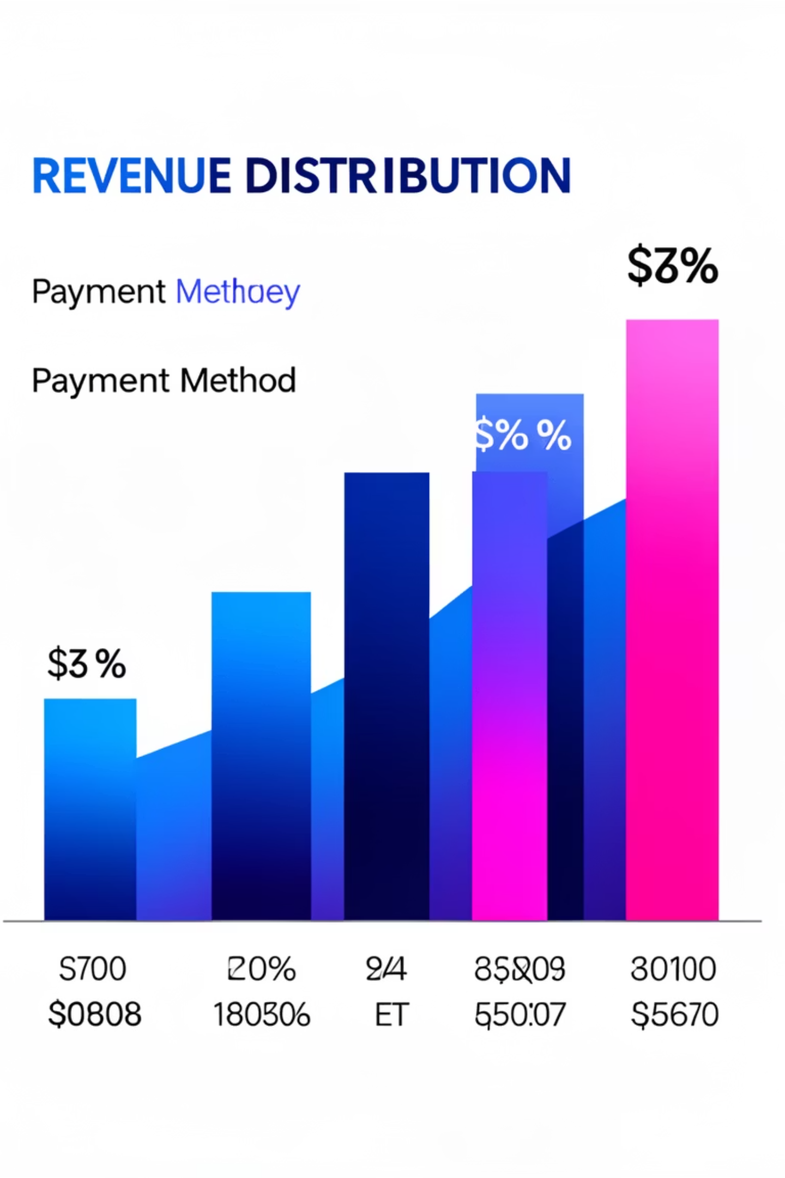
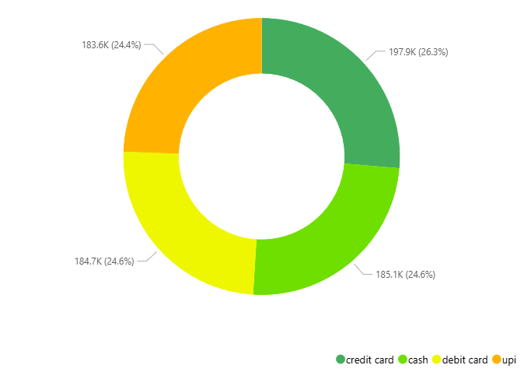
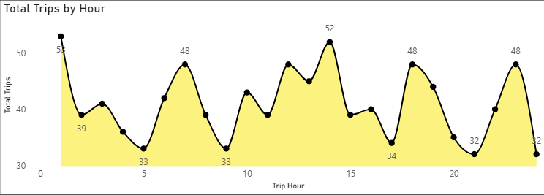
Trip Revenue Analysis: Executive Overview
2.16K
45.49%
₹751K
Total Trips
Completion Rate
Total Revenue
₹764
Average Fare
Peak booking hours are 0-1 and 13-14. Revenue is consistent across payment methods, with top pickup locations driving demand.

Slide 5


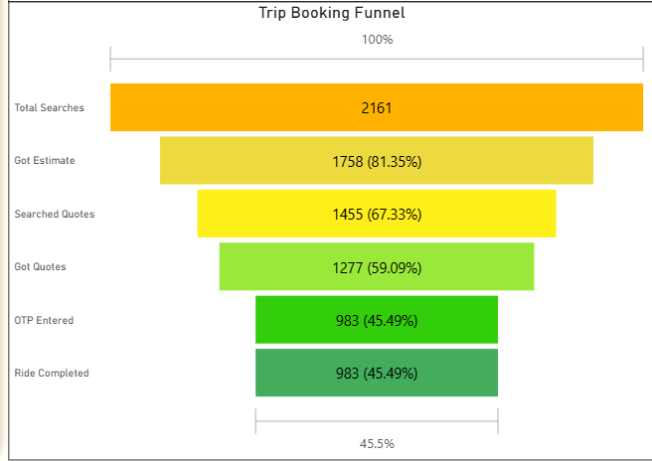



User Conversion Funnel Analysis
Total Searches
2.16K
Got Estimate
1.76K
Search for Quotes
1.46K
OTP Entered
983
Ride Completed
983
A significant drop-off occurs between "Search" and "Got Estimate." No cancellations after OTP entry.

Slide 6

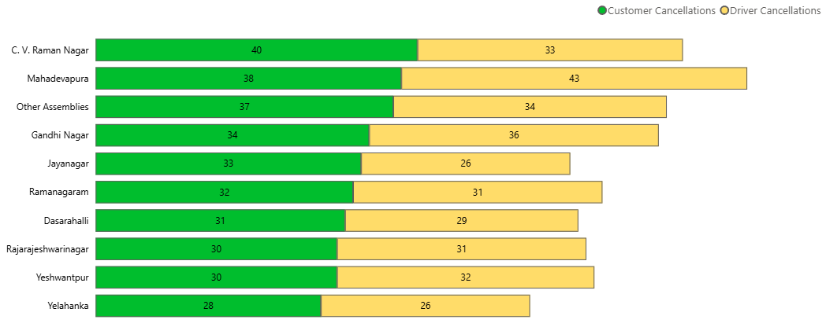
Location & Cancellation Insights
Location Analysis
Cancellation Analysis
High-demand locations often show low completion rates, indicating potential supply or driver availability issues.
Customer Cancellations: 1.04K (48.17%)
Driver Cancellations: 1.02K (47.25%)
Cancellations are nearly split between customers and drivers. Lack of fare estimates is a primary cause for customer cancellations.

Slide 7

Exploratory Data Analysis Highlights
Univariate Analysis
Bivariate Analysis
Fare and distance distributions are right-skewed, indicating a few high-value trips.
Strong correlation (0.69) between searches getting estimates and searches for quotes. Fare and distance patterns are consistent across payment methods.
Multivariate Analysis
Cancellation likelihood increases without fare estimates. Payment method does not influence fare or distance.

Slide 8
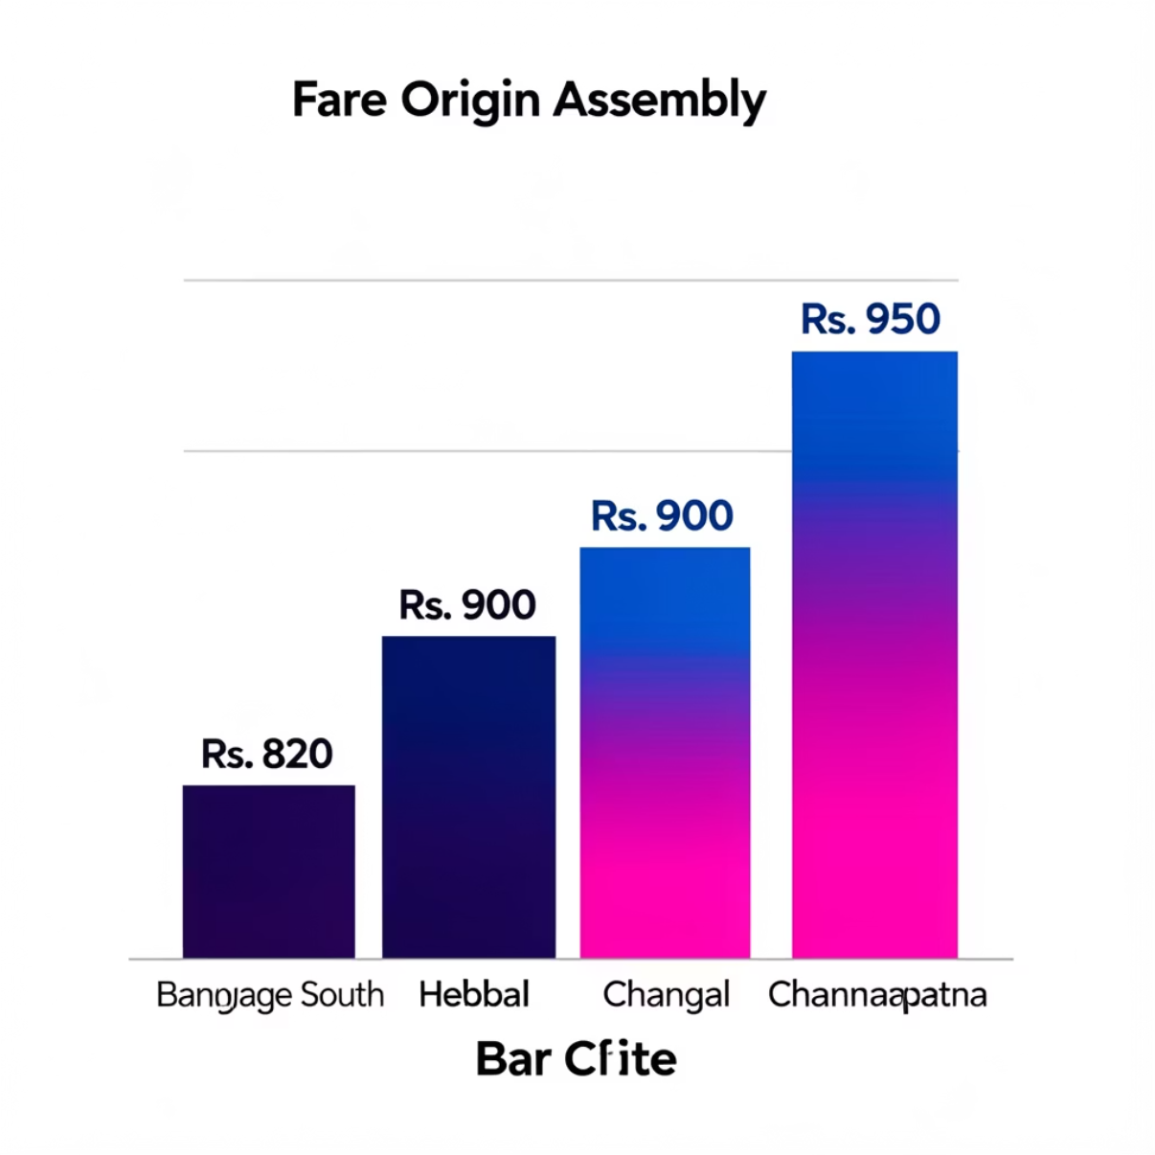
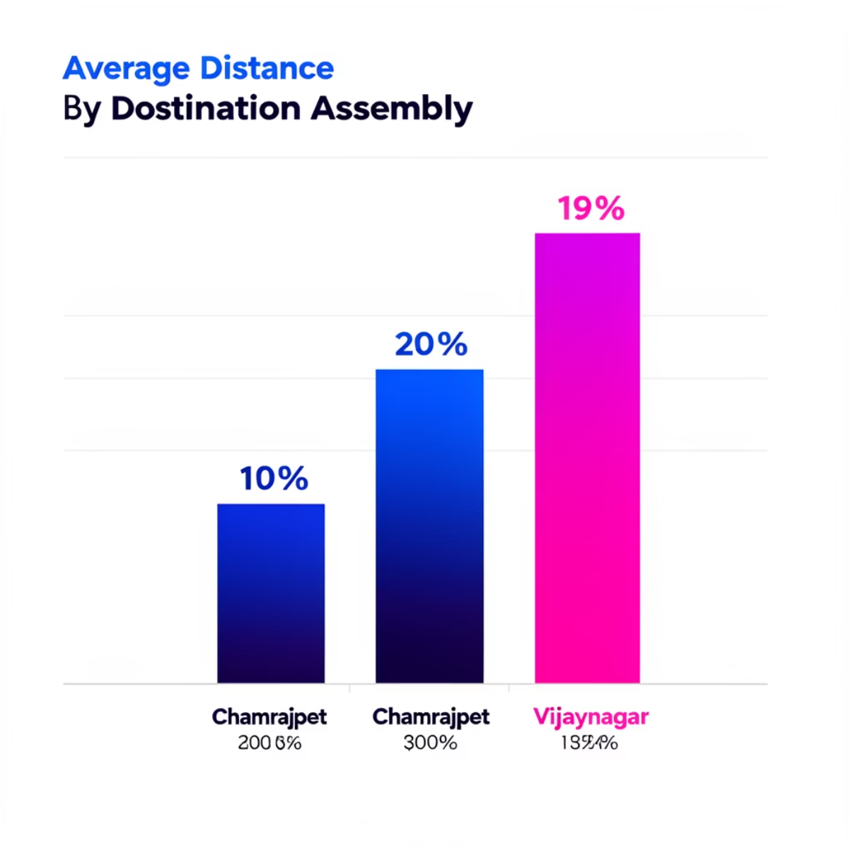
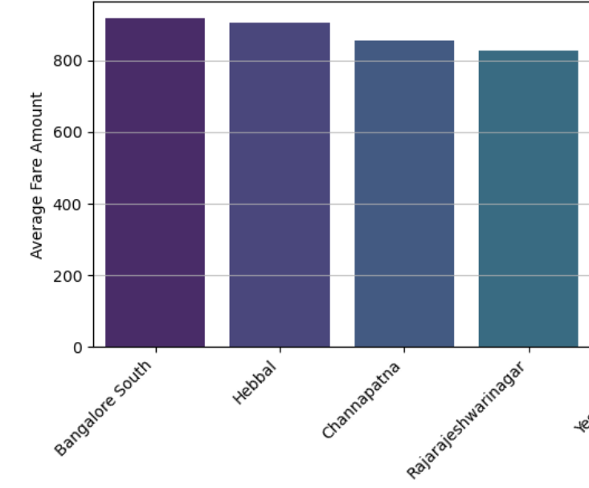

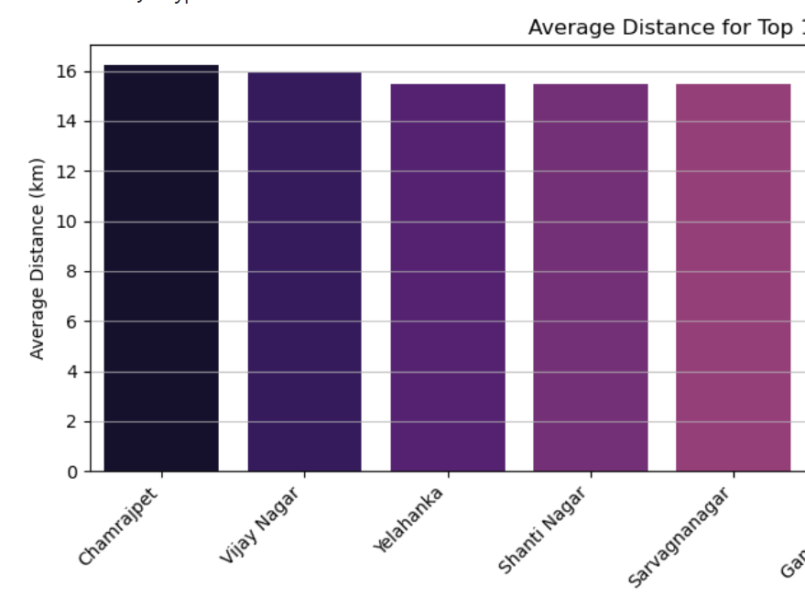
Top Origin & Destination Assemblies
Average Fare for Top 10 Origin Assemblies
Average Distance for Top 10 Destination Assemblies
Bangalore South and Hebbal show the highest average fare amounts, indicating premium routes or longer distances from these origins.
Chamrajpet and Vijaynagar have the longest average distances, suggesting these destinations are typically reached via longer trips.

Slide 9






Key Business Insights
Fare Estimate Critical
Availability of fare estimates is crucial for user conversion and reducing cancellations.
Payment Neutrality
Payment methods do not significantly impact fare or distance, ensuring transparent pricing.
Location Supply Gaps
Discrepancies in location-level supply affect completion rates, requiring targeted driver allocation.
Early Funnel Focus
Reducing cancellations requires improving the early stages of the booking funnel.

Slide 10
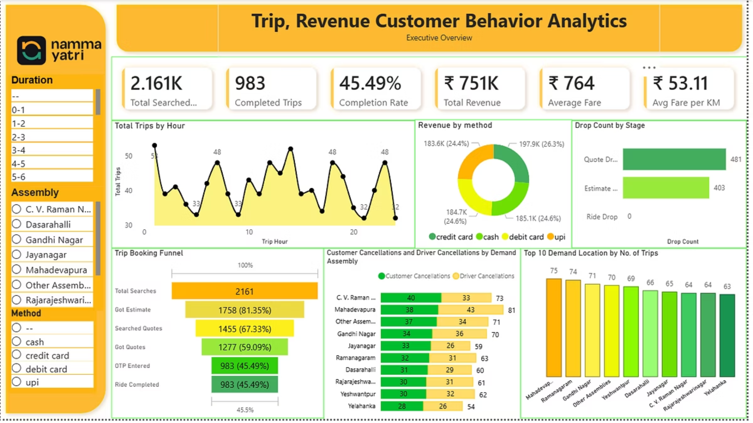
Conclusion & Outcomes
01
02
Improve Estimate Availability
Optimize Driver Allocation
Enhance the system to provide fare estimates more consistently to reduce customer cancellations.
Strategically deploy drivers to high-demand areas with low completion rates to balance supply and demand.
03
Maintain Transparent Pricing
Continue ensuring consistent and fair pricing across all payment methods to build user trust.
This project demonstrates strong analytical, visualization, and business interpretation skills, providing actionable strategies for NammaYatri's growth.

